Slide 1
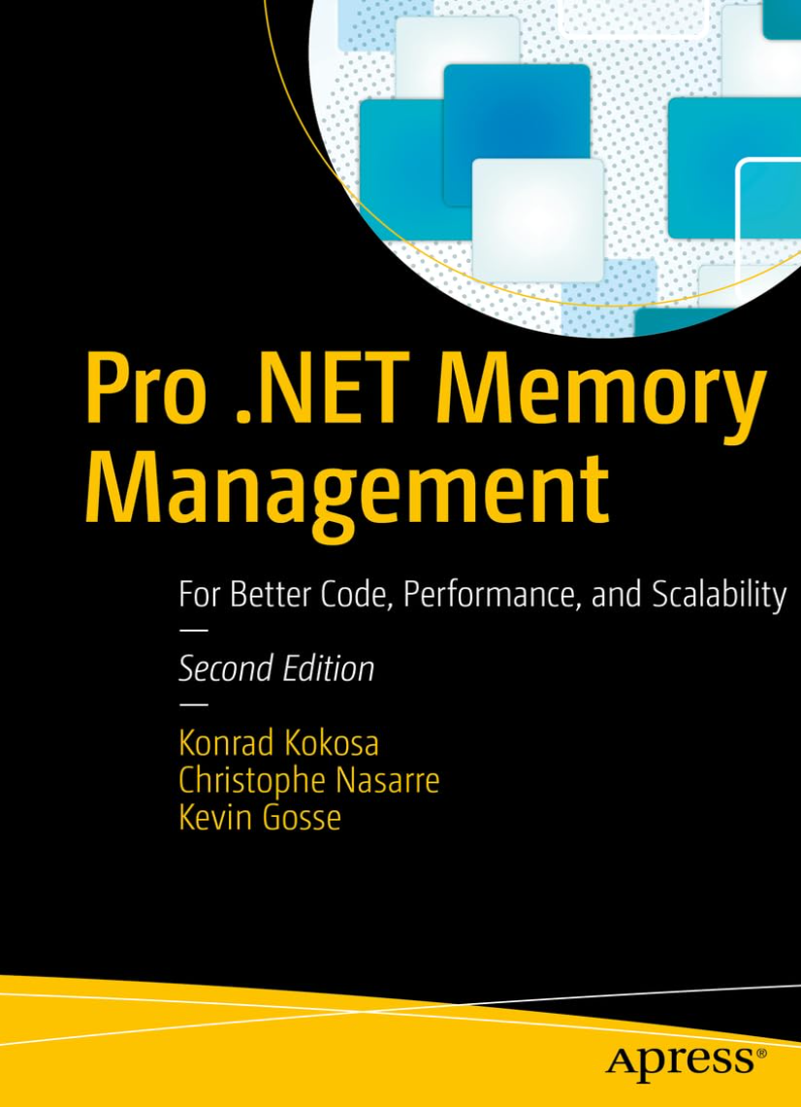

.NET CLI tools in the AI fury
Christophe Nasarre
Developer at Datadog
Twitter @chnasarre
@chrisnas.bsky.social
Notes:
SETUP
Open prompt in C:\Conferences\2026_CLItools\dumps
Open prompt in C:\Conferences\2026_CLItools\Code\GuidGen
Open Windows explorer in C:\Users\Christophe Nasarre\.nuget\packages for dnx
Open Process Explorer
Open VS 2026
load C:\github\chrisnas\UpdateConferencePrague2026\CLI tools\Code\CLITools.slnx
Open VS 2022
load C:\github\chrisnas\DebuggingExtensions\src\DebuggingExtensions.sln
Open DuplicatedStringsTool.cs
Open Program.cs
Open VS 2022
Load C:\github\chrisnas\GCStats\GCStats\GCStats.sln
Open dotnet-fullgc\Program.cs
Open https://www.nuget.org/
Open C:\Users\Christophe Nasarre\.cursor\skills\dotnet-memory-analysis\SKILL.md

Slide 2
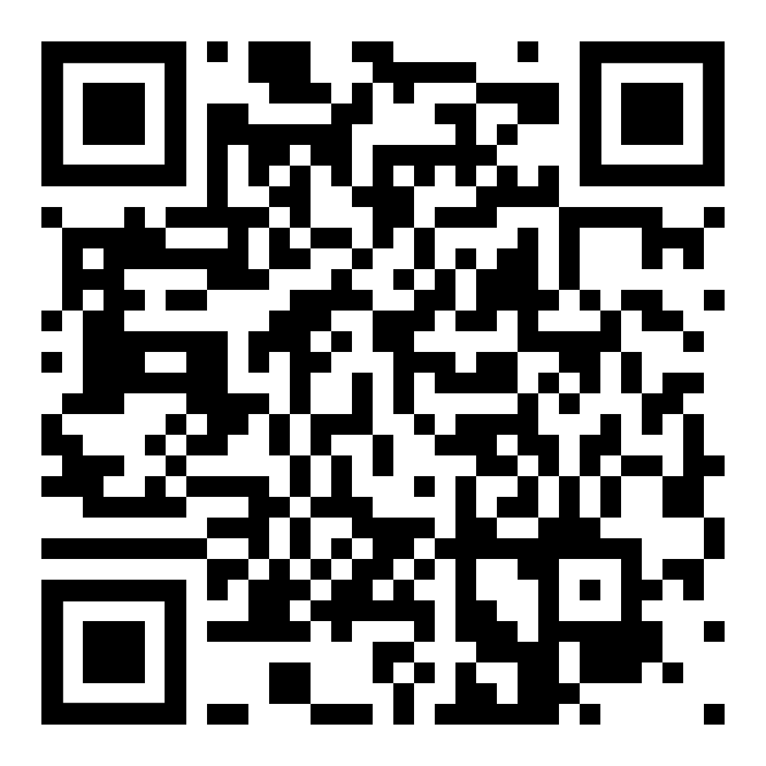
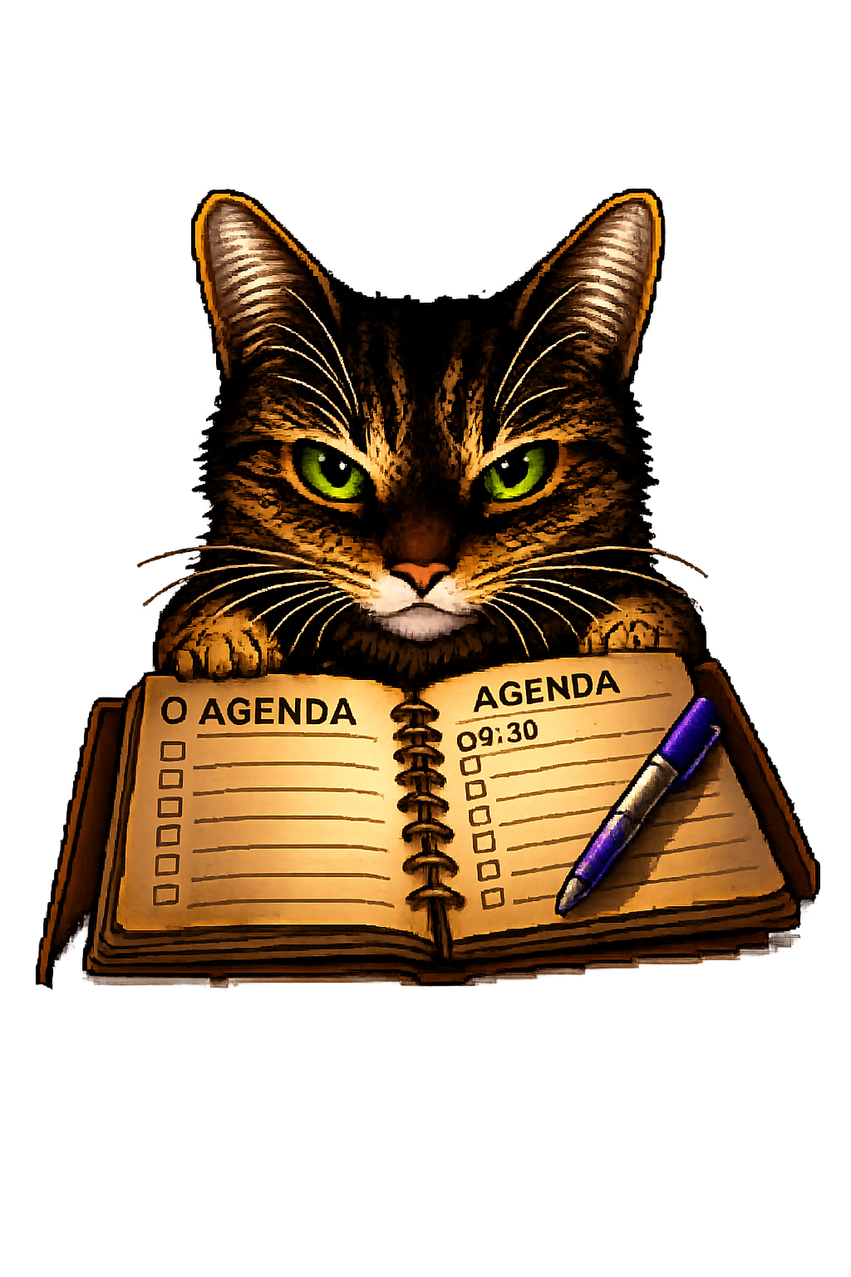
Agenda (focus on production issues)
Building CLI tools
Looking into .NET
AI loves CLI
Basics
Versioning
Beyond
TraceEvent
ClrMD
Commands
MCP server
Skills
Notes:
Due to the heavy usage of AI, and great blog posts series about CLI byt Andrew Locke, the agenda of this session has drastically changed since its creation.
Initially, I only wanted to tell you how to build your own CLI tools to better monitor your applications.
And I realized that AI could also be used to troubleshoot issues for which CLI tools would be very precious and easy to use by agent since text is now the new programming language… bye bye great Uis
So… 3 parts
1. Still how to build your own CLI
2. How to look into the CLR (even with undocumented ways)
3. And how to integrate these tools for a broader agentic usage
POLL: who is using agents for something unrelated to code generation like troubleshooting production issues?

Slide 3
What are .NET CLI tools?
= “console” apps distributed as NuGet packages with dotnet tool install
.NET SDK is required to install tools
  … but Microsoft is working on it!
List installed tools with dotnet tool list -g DEMO
  Local tools are also possible (for controlled versioning with manifest file; ex: CI)
Notes:
.NET tools = console apps distributed as NuGet packages, installed via dotnet tool install
DEMO:
Go to https://www.nuget.org/ and search for dotnet-dump and show the stats + source repo
Open prompt and show other dotnet tool commands
dotnet tool list –g
dotnet tool search "dotnet-" --take 100
NOTE: The dash naming is recommended for Microsoft tools only but… too late
Local tools: per-repo manifest in .config/dotnet-tools.json — version-pinned, checked into source control

Slide 4
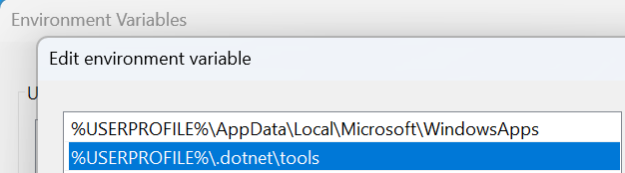
Run my CLI tool
<tool name>
  dotnet-dump to start dotnet-dump …because the folder is added to the PATH
dotnet <tool name without dash>
  dotnet dump to start dotnet-dump
Where are they installed on disk? DEMO
  shim =
  c:\users\<user>\.dotnet\tools\<tool name>.exe
  real = c:\users\<user>\.dotnet\tools
  \.store\<tool name>\<version>\<tool name>\<version>\tools\net<version>\any\<tool name>.dll
  … but could be set with --tool-path
Notes:
DEMO:
Open a prompt
cd C:\Conferences\2026_CLItools\Dumps
dotnet dump analyze dump_20260322_091556.dmp
Start procexp and look at the loaded dlls for dotnet-dump.exe
dotnet-dump.exe in C:\Users\Christophe Nasarre\.dotnet\tools is just a proxy to the real .dll in a sub folder below

Slide 5
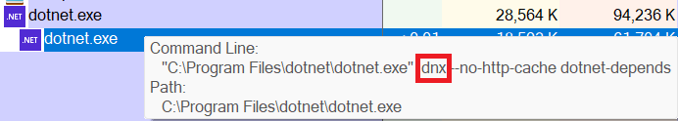
Run my CLI tool (please)
Strong runtime version association
  û Tools older than the runtime version
Use --allow-roll-forward
  …when a tools is older than the runtime version
(.NET 10) dnx
  Download, run and discard
  Like npx for .NET
  Keep a cache in C:\Users\<current user>\.nuget\packages\<tool name>
Notes:
DEMO:
Open prompt
cd C:\Conferences\2026_CLItools\Code\GuidGen
dnx dotnet-depends
CTRL+D to get the reverse links between assemblies and projects
dotnet depends
→ Nothing happens even though there is a download cache
→ Show C:\Users\Christophe Nasarre\.nuget\packages where dotnet-depends was downloaded

Slide 6
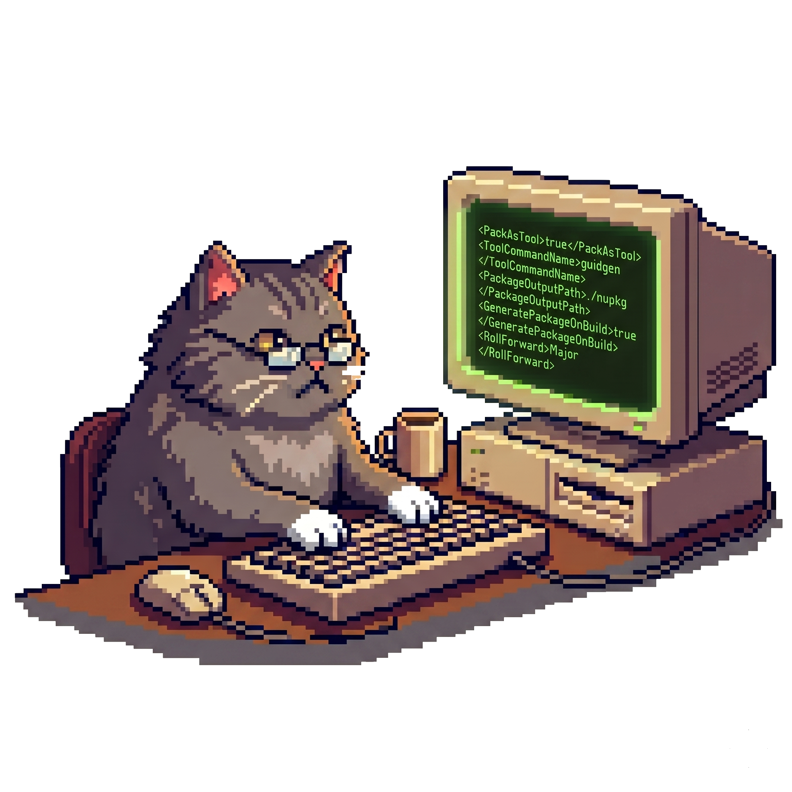
Authoring a .NET CLI tool
Everything is in the .csproj! DEMO
Tool packaging
<PackAsTool>true</PackAsTool>
<ToolCommandName>guidgen</ToolCommandName>
<PackageOutputPath>./nupkg</PackageOutputPath>
<GeneratePackageOnBuild>true</GeneratePackageOnBuild>
Runtime compatibility… or AOT (GuidGen.Aot)
<RollForward>Major</RollForward>
→ Avoid large <TargetFrameworks>
Notes:
DEMO:
Open CLITools.sln
Set Guidgen as startup project
Run the executable from VS – CTRL+F5
Open GuidGen.csproj file
Could be interesting to build in AOT = no .NET version dependency!!
Slides — csproj properties explained:
PackAsTool + ToolCommandName: mark the project as a tool and set the CLI command name
Naming convention: the ToolCommandName should not start with dotnet- — that prefix is informally reserved for official Microsoft tools (e.g. dotnet-counters, dotnet-trace). Notable exception: dotnet-gcmon by Maoni Stephens (GC team at Microsoft). For community tools, prefer a short distinctive name like guidgen.
PackageId: NuGet package name (convention: dotnet-<name> so dotnet guidgen works)
Title: display name on NuGet.org (distinct from PackageId)
Authors: your real name (e.g. "Christophe Nasarre") — displayed on NuGet.org package page
Owners: your NuGet.org / GitHub account (e.g. "chrisnas") — used for package ownership on NuGet.org
Version, Description: NuGet metadata shown during dotnet tool search and on NuGet.org
PackageLicenseExpression: SPDX license identifier (e.g. MIT, Apache-2.0). Alternative: PackageLicenseFile to embed a custom license file in the package (requires a <None Include="LICENSE.txt" Pack="true" PackagePath="\" /> item, same pattern as README). See packing a license expression or a license file. Only one of the two can be specified.
Copyright: supports MSBuild expressions — $([System.DateTime]::UtcNow.ToString(yyyy)) auto-updates the end year at build time
RepositoryType + RepositoryUrl: marks the package as backed by a git repository; enables Source Link integration
PackageTags: help discoverability
PackageReleaseNotes: changelog shown on the NuGet.org package page for each version
PackageReadmeFile: embeds a README.md into the .nupkg — displayed on the NuGet.org package page (best practice per NuGet authoring guidelines); requires a <None Include="README.md" Pack="true" PackagePath="\" /> item
RollForward=Major: forward compatibility with future runtimes (detailed in Section 3)

Slide 7

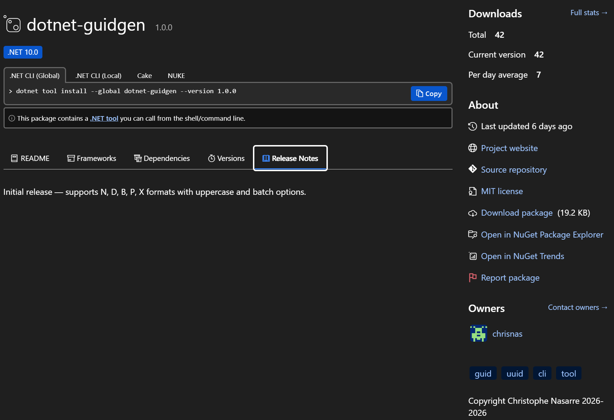
Authoring a .NET CLI tool
<Title>
<Version>
<PackageProjectUrl>
<PackageReadmeFile>
<PackageRepositoryUrl>
<PackageReleaseNotes>

Slide 8
Authoring a .NET CLI tool
<RepositoryType>
<PackageLicenceExpression>
<Owners>
<PackageTags>
<Copyright>

Slide 9

Testing a .NET CLI tool
Uninstall current version if any
dotnet tool uninstall -g dotnet-dstrings
Install from the source folder
dotnet tool install -g dotnet-dstrings --add-source ./dotnet-dstrings/nupkg --version 2.1.0

Slide 10
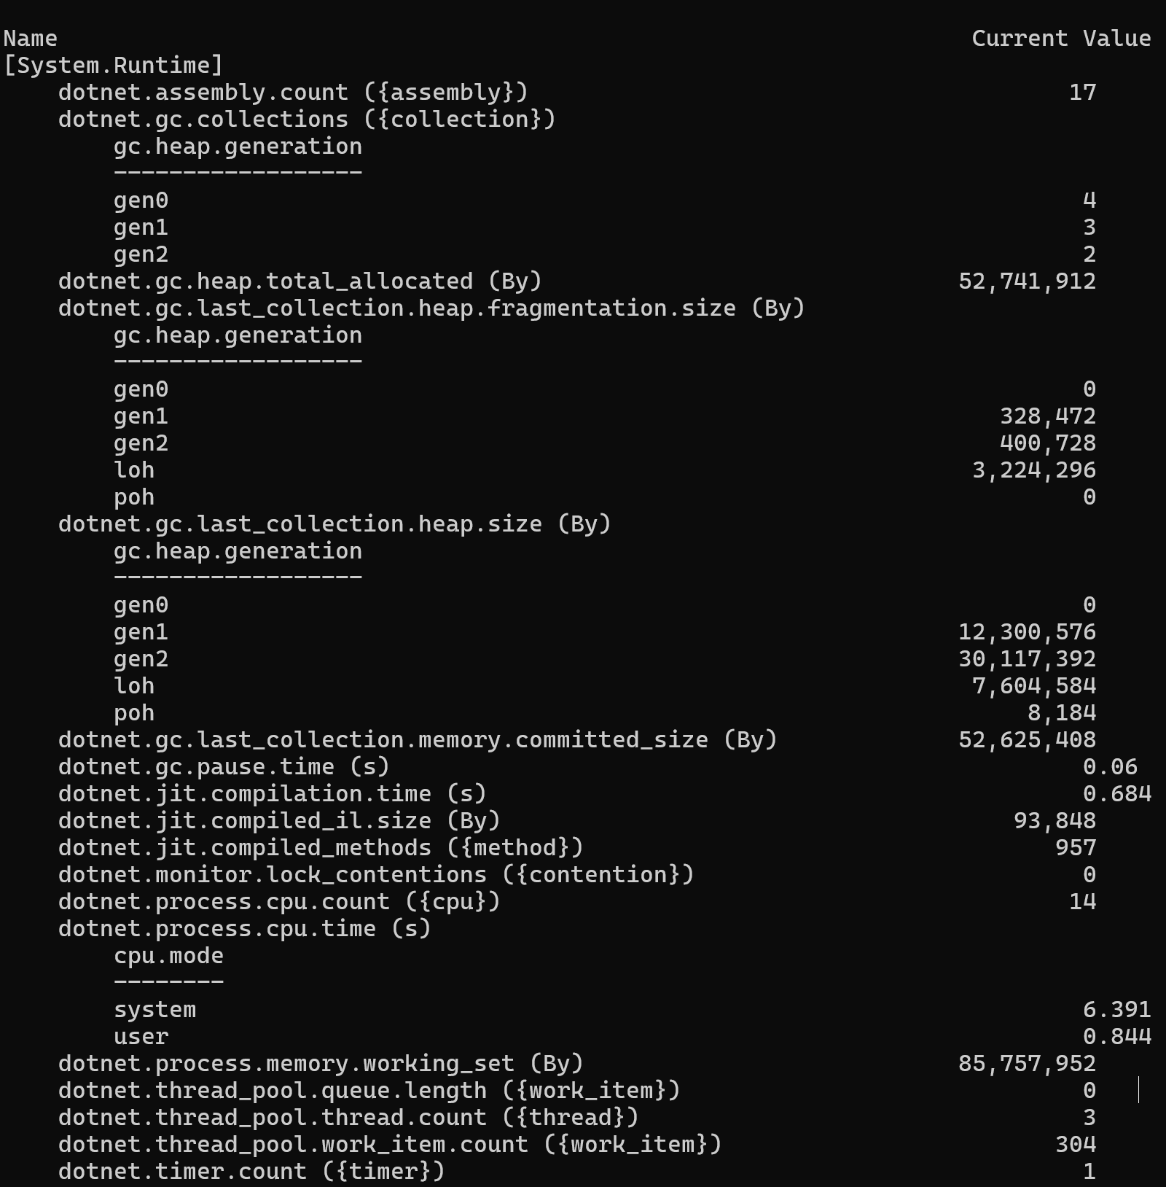
Look inside the CLR (1/2)
Existing Microsoft CLI tools
dotnet-counters — monitor real-time counters and metrics

Slide 11
Look inside the CLR (1/2)
Existing Microsoft CLI tools
dotnet-counters — monitor real-time counters and metrics
dotnet-trace — collect events from BCL/CLR/+ (.nettrace files)

Slide 12
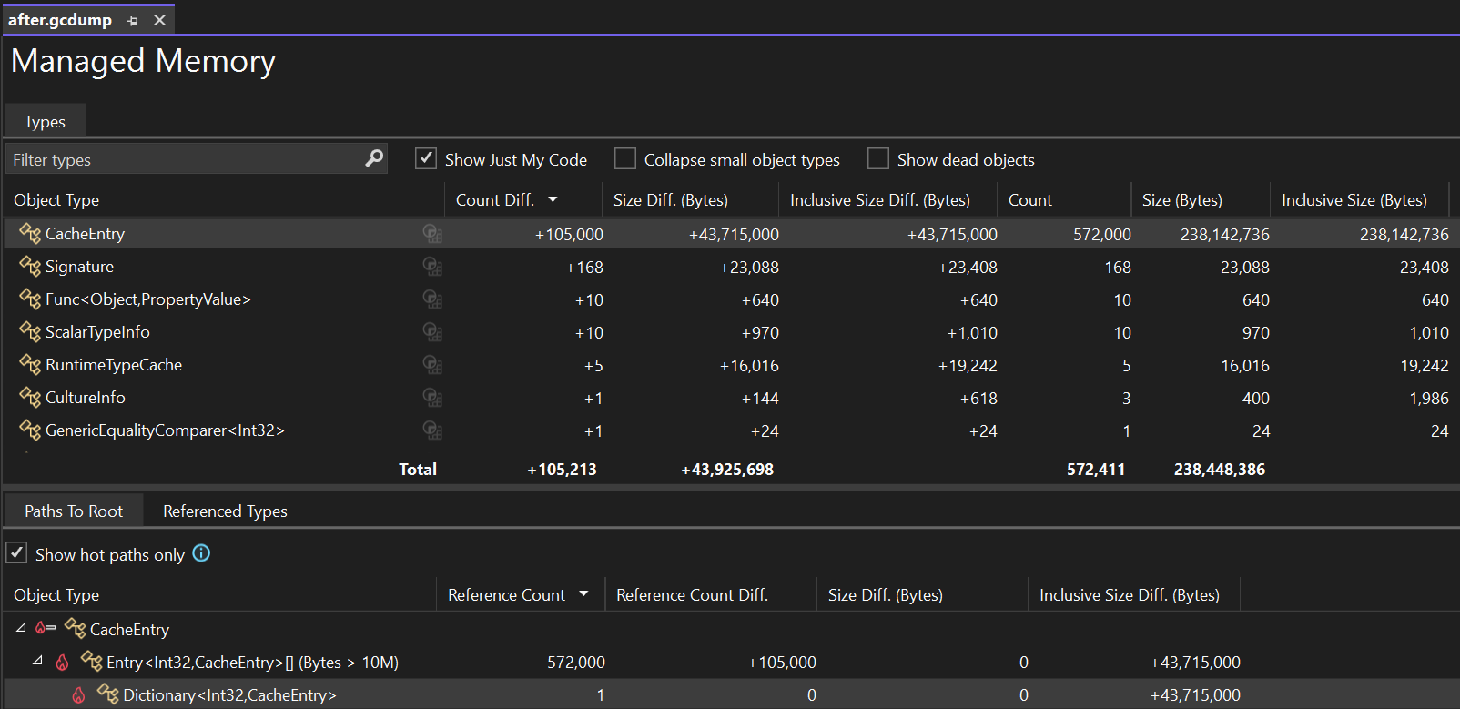
Look inside the CLR (1/2)
Existing Microsoft CLI tools
dotnet-counters — monitor real-time counters and metrics
dotnet-trace — collect events from BCL/CLR/+ (.nettrace files)
dotnet-dump — capture and analyze memory dumps (SOS commands)
dotnet-gcdump — capture GC heap snapshots (lighter than full dumps)

Slide 13
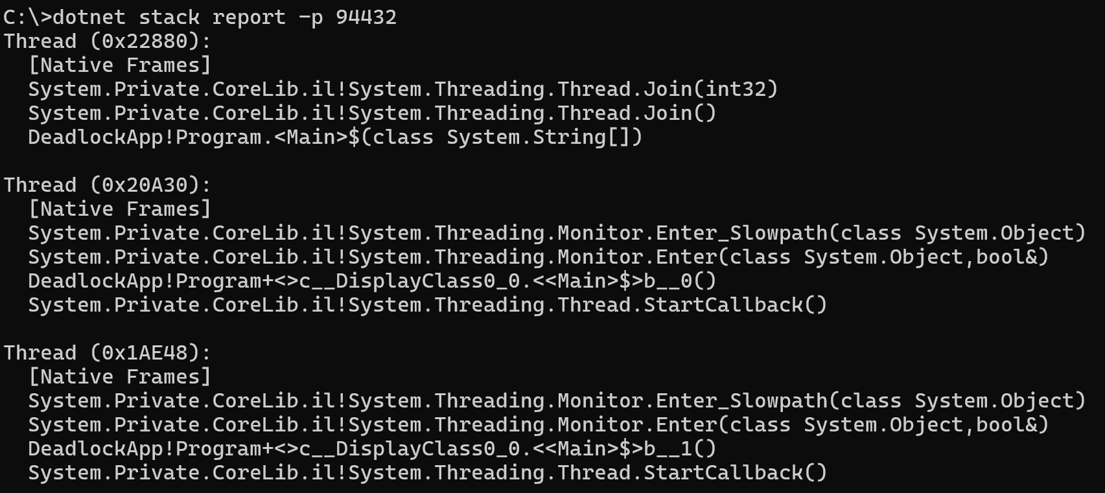
Look inside the CLR (1/2)
Existing Microsoft CLI tools
dotnet-counters — monitor real-time counters and metrics
dotnet-trace — collect events from BCL/CLR/+ (.nettrace files)
dotnet-dump — capture and analyze memory dumps (SOS commands)
dotnet-gcdump — capture GC heap snapshots (lighter than full dumps)
dotnet-stack — show managed stacks of a running process threads
dotnet-sos — install the SOS debugging extension
dotnet-symbol — download symbols, DAC, and modules for debugging

Slide 14
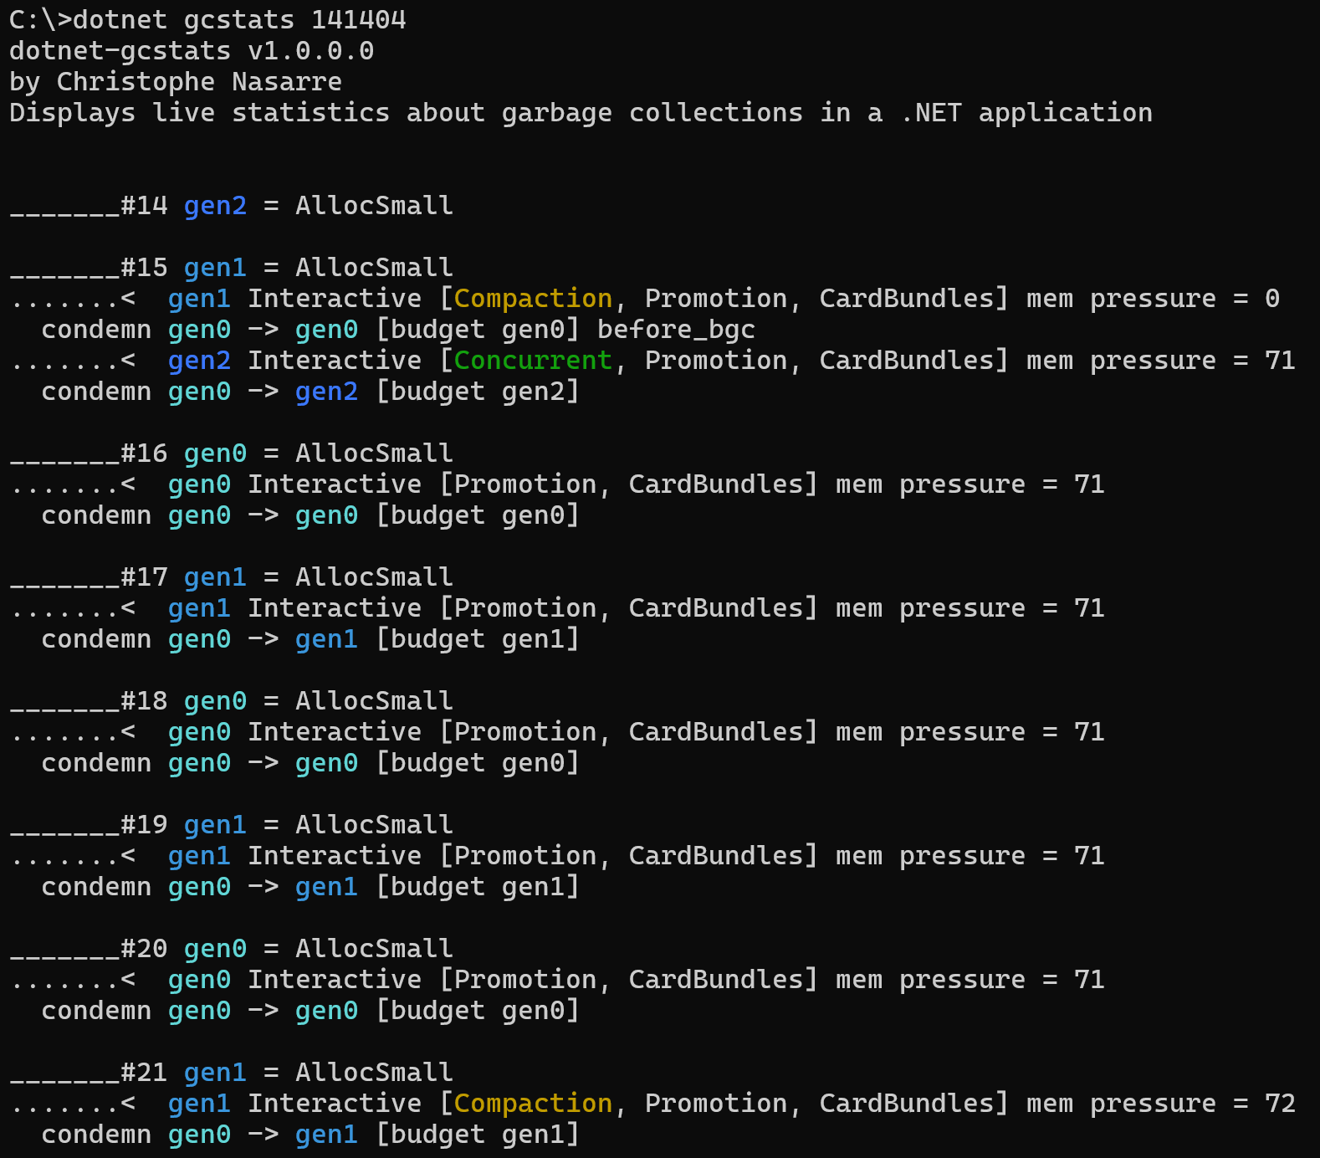
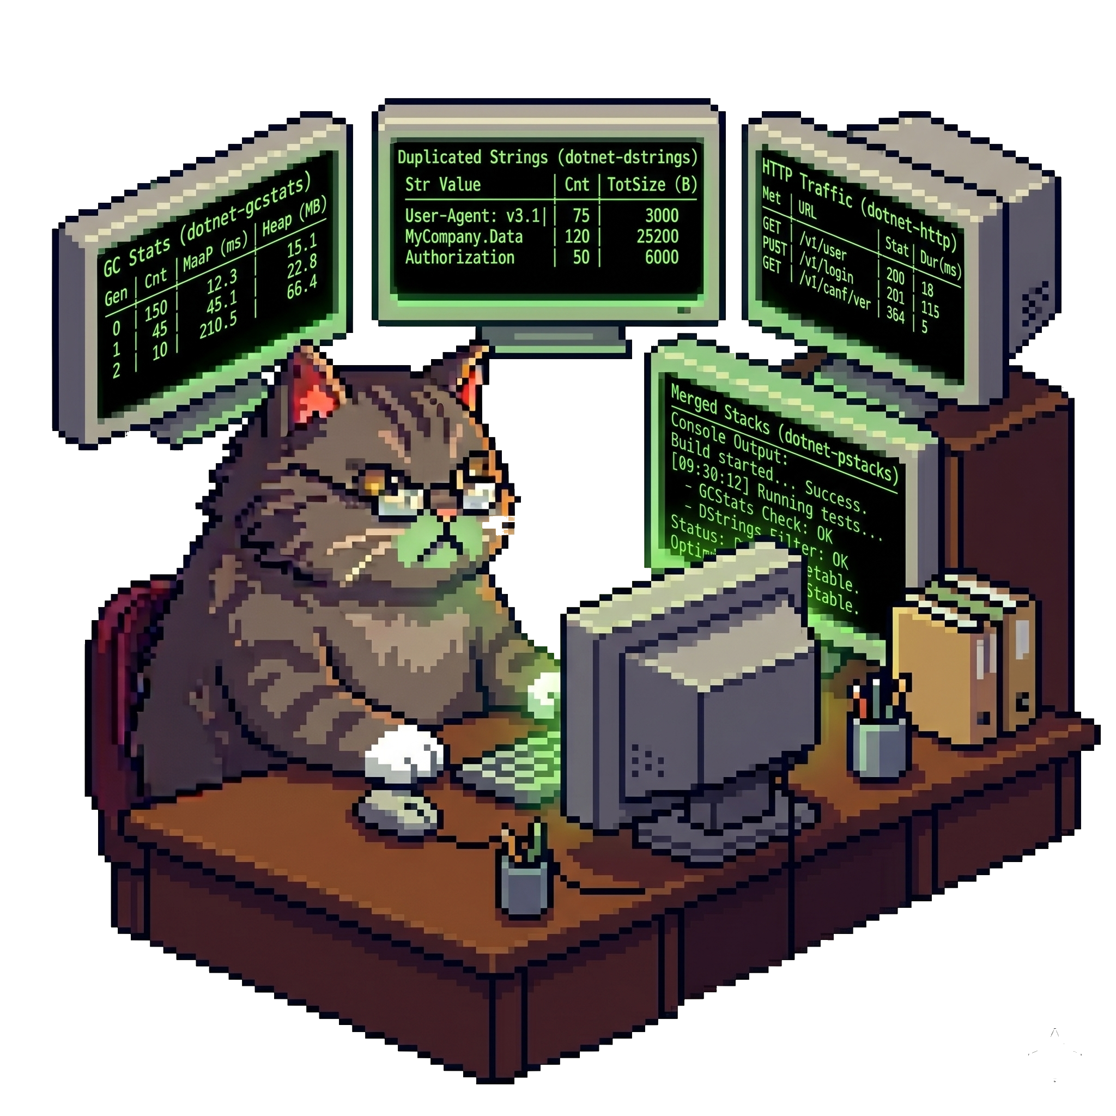
Look inside the CLR (2/2)
Other tools
dotnet-gcmon — monitor GCs in real-time
dotnet-gcstats — monitor GCs in real-time

Slide 15
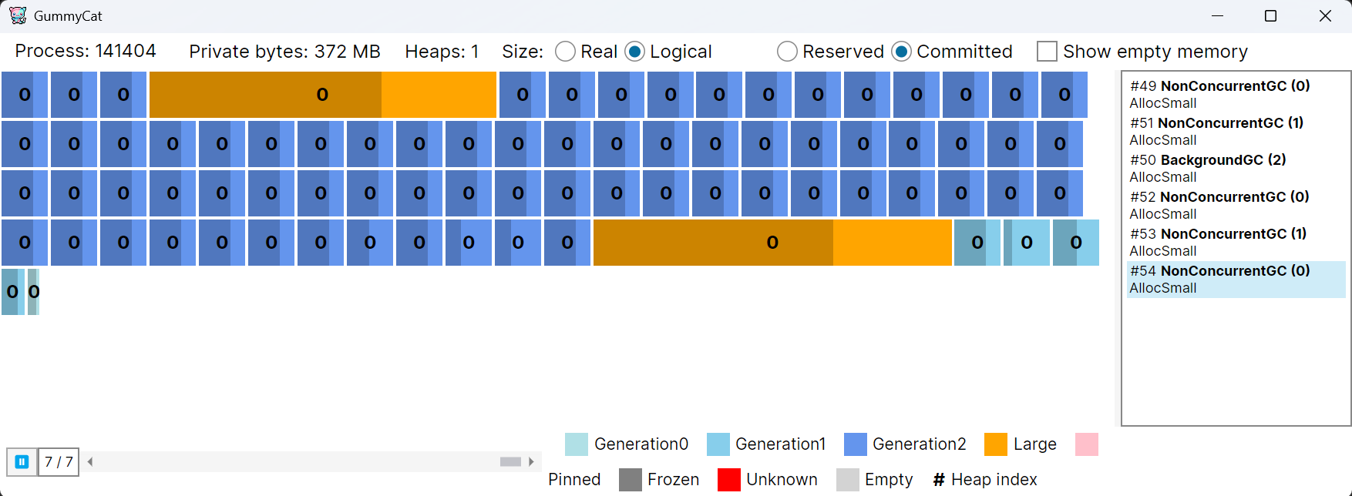
Look inside the CLR (2/2)
Other tools
dotnet-gcmon — monitor GCs in real-time
dotnet-gcstats — monitor GCs in real-time
GummyCat — monitor GCs in a GUI

Slide 16
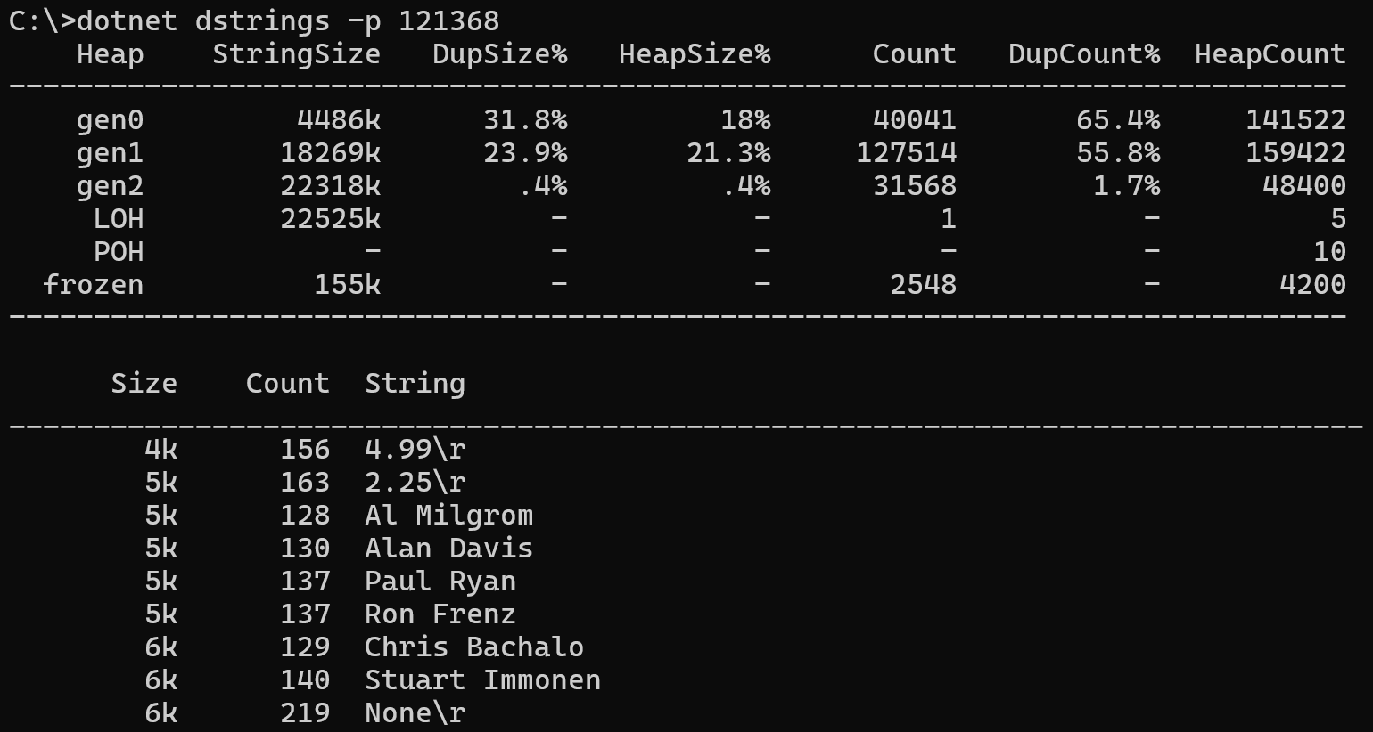
Look inside the CLR (2/2)
Other tools
dotnet-gcmon — monitor GCs in real-time
dotnet-gcstats — monitor GCs in real-time
GummyCat — monitor GCs in a GUI
dotnet-dstrings — look for duplicated strings

Slide 17
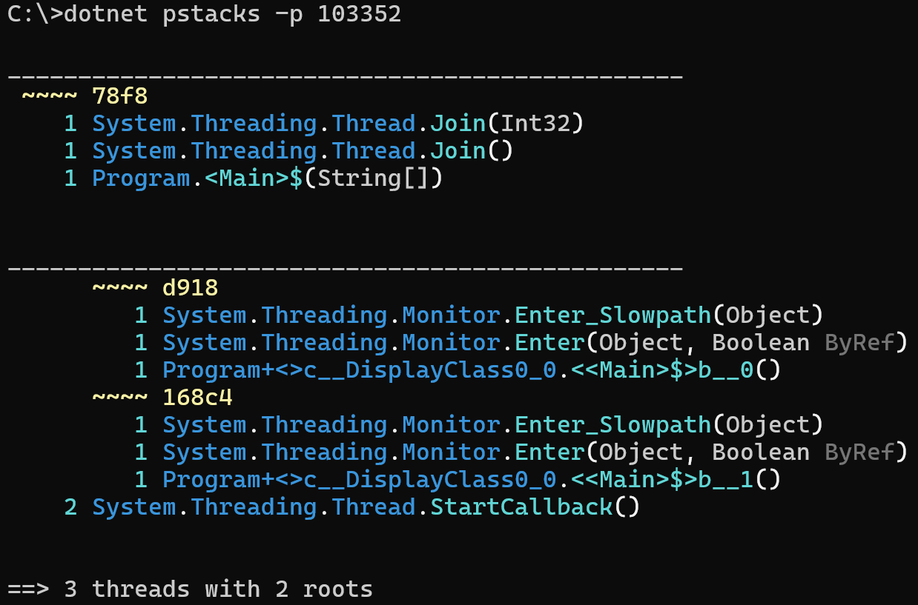
Look inside the CLR (2/2)
Other tools
dotnet-gcmon — monitor GCs in real-time
dotnet-gcstats — monitor GCs in real-time
GummyCat — monitor GCs in a GUI
dotnet-dstrings — look for duplicated strings
dotnet-pstacks — show merged call stacks

Slide 18
Look inside the CLR (2/2)
Other tools
dotnet-gcmon — monitor GCs in real-time
dotnet-gcstats — monitor GCs in real-time
GummyCat — monitor GCs in a GUI
dotnet-dstrings — look for duplicated strings
dotnet-pstacks — show merged call stacks
dotnet-http — monitor outgoing http requests
dotnet-wait — list waits such as lock contention
dotnet-fullgc — trigger a GC

Slide 19
How to look inside the CLR?
Listen to CLR and BCL events
  Look at ClrEtwAll.man file for CLR events (provider + keyword + verbosity)
  Look for EventSource derived class in BCL + documentation + http-related post
Data access with ClrMD
  Memory, thread and more
  Reference Microsoft.Diagnostics.Runtime package
Send commands
  Specific commands are available + special case to trigger a garbage collection
Notes:
All these tools are built on top of these 3 mechanisms: TraceEvent, ClrMD and commands
CLR events:
Exceptions
Thread contention
Finalized objects
Allocation sampling (new more accurate algorithm since .NET 10)
GC details including suspension time
BCL events:
HTTP and network
Wait such as Mutex

Slide 20
Listen with TraceEvent
Reference TraceEvent
  Ask for provider + keyword + verbosity
Monitored Application
DiagnosticServer
Monitoring tools
static DWORD DiagnosticsServerThread(...)
{
switch(message)
{
case EventPipe:
EventPipeProtocolHelper::HandleIpcMessage()
case ...:
}
}
DiagnosticsClient
EventPipeSession
Named Pipe (Windows)
EventPipe
Domain Socket (Linux)
EventPipeEventSource.All += ...
or
ClrTraceEventParser C# events
Notes:
DEMO: show the code for dotnet-fullGC\Program.cs in GCStats solution for the code to write in a monitoring tool
Behind the scene, the CLR creates a dedicated thread to listen to requests and emit events via EventPipe (Named pipe on Windows and Domain socket on Linux)
In your tools:
Create a DiagnosticsClient to bind to a .NET process
Create an EventPipeSession
Register your handlers on an EventPipeEventSource bound to the session
Your handlers will be called when events are received
Tools using TraceEvent:
dotnet-trace
dotnet-counters
dotnet-gcstats
dotnet-gcmon
dotnet-http
dotnet-wait
GummyCat
NOTE: you could also listen in-process to events

Slide 21

Counters/Metrics case
CLR and BCL are emitting Open Telemetry compatible metrics (.NET 8+)
  Look at dotnet-counters
Deprecated CLR and ASP.NET Core counters
Build your own!
  Read Andrew Lock blog series about metrics
Notes:
dotnet-counters is used to collect metrics and counters

Slide 22
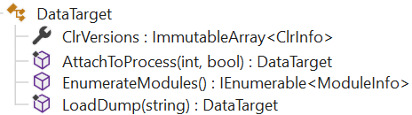
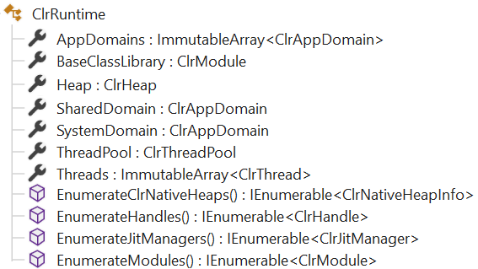
Use ClrMD Luke!
Allow access to live processes and memory dump: DataTarget
Get a ClrRuntime from ClrInfo.CreateRuntime()

Slide 23
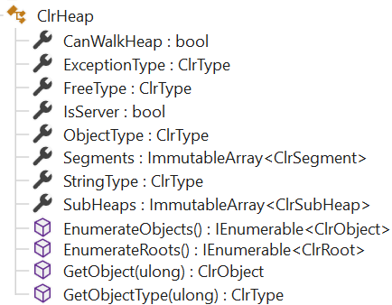
Zoom in the Managed Heap
Everything starts from ClrHeap

Slide 24
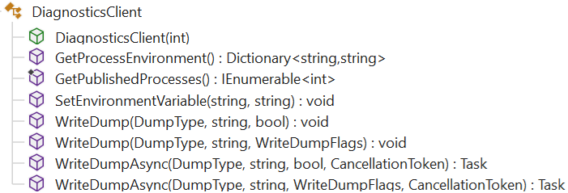
Send a direct command
Use (Microsoft.Diagnostics.NETCore.Client) DiagnosticsClient DEMO lp
Notes:
DEMO
Show the code for lp (List Processes)
Beware of timeouts

Slide 25
AI & CLI tools
User
prompt
“
Œ
final response
Ž
enriched message
Agent Harness
Models (LLM)
Context Assembler
Skills
tool calls

…

P
‘
tool results
Tool Dispatcher
MCP
servers
model response
’

tools call
tools response
Environment
Notes:
1. The Conversation Loop
The harness manages the turn-based loop between user and model:
The user sends a message.
The harness enriches the message with context (open files, cursor position, linter errors, system rules, etc.) and sends it to the model.
The model responds — either with text for the user, or with tool calls.
If tool calls are present, the harness executes them, collects the results, and sends them back to the model.
Steps 3–4 repeat in a loop until the model produces a final text response with no tool calls.
The response is shown to the user, and the loop waits for the next user message.
This is the heartbeat of the agent. The model never talks directly to the user or directly to tools — the harness mediates everything.
2. Context Assembler
Before each call to the model, the harness assembles the prompt context. This includes:
System prompt: The model's role, persona, rules, coding conventions (like the workspace rule from your CLAUDE.md saying "you are a very senior C++ developer").
Workspace rules: Always-applied rules, file-specific rules, project conventions.
User state: Open files, cursor position, recently viewed files, edit history, linter diagnostics.
Agent skills: Descriptions of available skills the model can choose to invoke.
MCP server metadata: Available MCP tools and resources.
Mode enforcement: Whether the agent is in "Ask mode" (read-only) or "Agent mode" (read-write).
Conversation history: Prior messages and tool results in the session.
The context assembler decides what the model sees. The model cannot perceive anything the harness doesn't inject. This is why, for example, when a subagent is launched, the harness explicitly states: "the subagent invocation does not have access to the user's message or prior assistant steps" — the subagent gets a fresh context window.
3. Tool Dispatcher
When the model emits tool calls (e.g., Read, Shell, Grep, StrReplace), the harness:
Validates the call (correct parameters, file paths, etc.).
Enforces policies (e.g., in Ask mode, write tools are blocked).
Executes the tool against the real environment.
Captures the result (file contents, command output, search results).
Returns the result to the model for the next reasoning step.
The tool dispatcher is what gives the model "hands" — without it, the model can only produce text.

Slide 26
AI: CLI tool → MCP server!
Agents (~models) could simply know how to use CLI tools
  --? could be used by agents to know how to use them
… but better to make it explicit = MCP Server
MCP Server = tools + prompts + resources via a transport (stdio, websockets, …)
Discoverable from agentic tools (Cursor, Copilot, Claude,…)

Slide 27
CLI as an C# MCP Server
dotnet-dstrings use case DEMO
Add ModelContextProtocol and Microsoft.Extensions.Hosting references
Support --mcp command line parameter
Add tools = static classes decorated with [McpServerToolType]
            Decorate static method with [McpServerTool, Description(…)]
            Decorate each parameter with [Description(…)]
Add prompts = static classes decorated with [McpServerPromptType]
            Decorate static method with [McpServerPrompt(Name=…), Description(…)]
            Decorate each parameter with [Description(…)]
Add server.json for easier usage by agentic clients and discovery in nuget.org
Notes:
NOTE:
- Prompts are not always used; for example in claude
DEMO:
Open dotnet-dstrings.csproj
Look at the dependecies
In main.cs, look at --mcp support
Look at the tool .cs files in Tools folder and show the different attributes
Look at the 3 prompts and show the different attributes
Open the server.json file and explain the different elements + note the way the version is kept in sync with the assembly and the nuget package

Slide 28
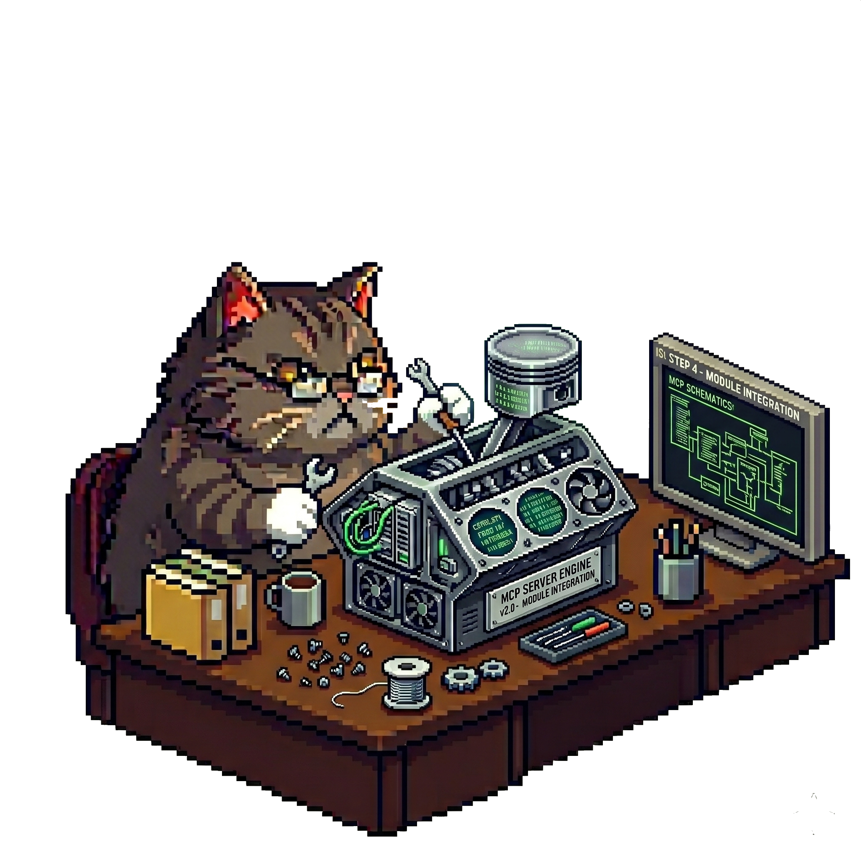
Build a new C# MCP Server
Install the Visual Studio project template
  dotnet new install Microsoft.McpServer.ProjectTemplates
Generate a nuget package
  <PackAsTool>true</PackAsTool>
  <PackageType>McpServer</PackageType> !!! WARNING !!!
Add .mcp\server.json
  Used by clients to know how to start the server
Notes:
https://learn.microsoft.com/en-us/dotnet/ai/quickstarts/build-mcp-server
= install the latest C# MCP Server project template :
dotnet new install Microsoft.McpServer.ProjectTemplates
In .csproj:
<PackageType>McpServer</PackageType>
!!! can’t be both dotnettool and mcpserver !!!
DEMO:
https://www.nuget.org/packages?packagetype=dotnettool
https://www.nuget.org/packages?packagetype=mcpserver
look at the CLR implementation to see if "dotnet tool install -g <tool name>" only search for dotnettool packagetype in nuget.org
The NuGetPackageDownloader is a generic package downloader -- it doesn't filter by DotnetTool itself. The filtering happens higher up in the tool installation pipeline. Let me find where.
Now I have the complete picture. Here's the answer:No, dotnet tool install -g does NOT filter by DotnetTool package type during the NuGet search/download phase.
The filtering happens after the package has already been downloaded and extracted.Here's the exact flow in the CLR/SDK implementation:
1. Download phase -- no package type filter
ToolPackageDownloaderBase.DownloadTool() calls DownloadAndExtractPackage(), which uses the generic NuGetPackageDownloader to find and download the package. The NuGetPackageDownloader.GetPackageMetadataAsync() queries NuGet feeds using PackageMetadataResource.GetMetadataAsync() with only package ID, prerelease, and unlisted flags -- no package type filter is applied. Any package matching the ID will be downloaded.
2. Validation phase -- post-download check
The DotnetTool package type check happens in ToolPackageDownloader.CreateAssetFile(), after the package is already on disk. Here's the key code:
if (!package.Nuspec.GetPackageTypes().Any(pt =>
pt.Name.Equals(PackageType.DotnetTool.Name, StringComparison.OrdinalIgnoreCase) ||
pt.Name.Equals("DotnetToolRidPackage", StringComparison.OrdinalIgnoreCase)))
{
throw new ToolPackageException(string.Format(CliStrings.ToolPackageNotATool, packageId));
}
This reads the .nuspec from the already-extracted package and checks whether its PackageType list contains either DotnetTool or DotnetToolRidPackage. If neither is present, it throws ToolPackageException.
Summary
The dotnet tool install pipeline:Downloads the package by ID only (no type filter on the NuGet query).
Extracts it locally.
Validates the .nuspec package types contain DotnetTool or DotnetToolRidPackage.
Throws if validation fails -- but you've already paid the download cost.
This is also confirmed by issue #37010, which reports that running dotnet tool install on a non-tool package produces a confusing DirectoryNotFoundException instead of a clean "not a tool" error, precisely because the download succeeds but the post-download validation/asset-creation path fails.

Slide 29
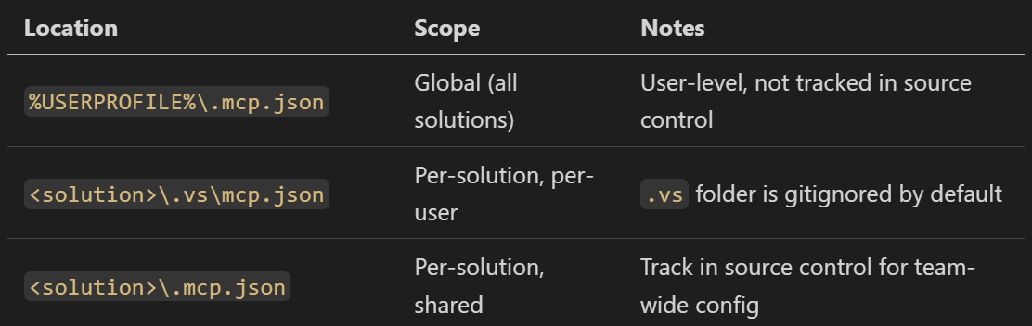
Use MCP Server in VS

Slide 30
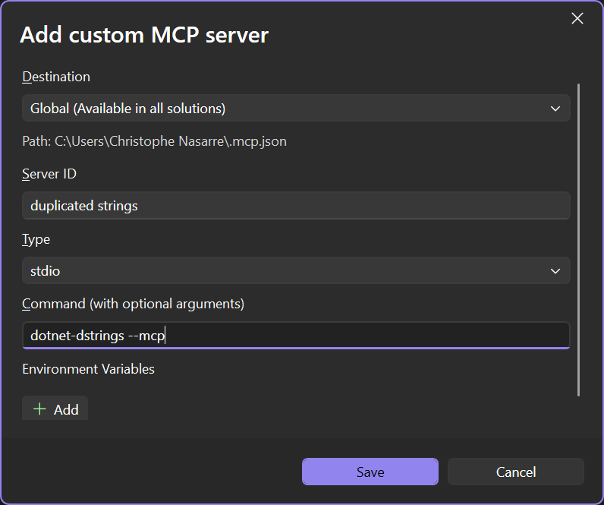
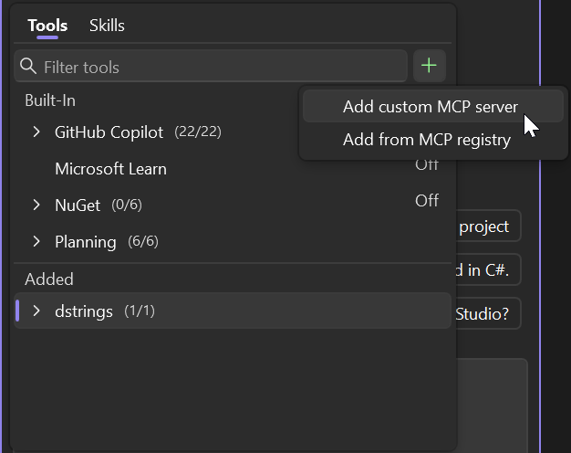
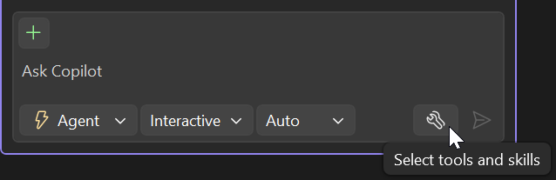
Use MCP Server in VS

Slide 31
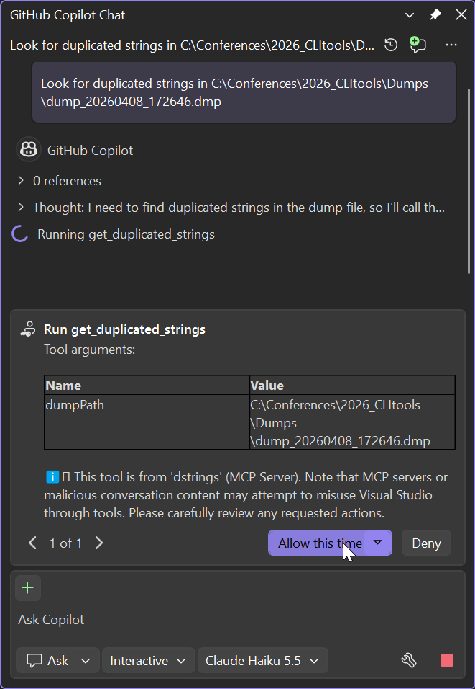
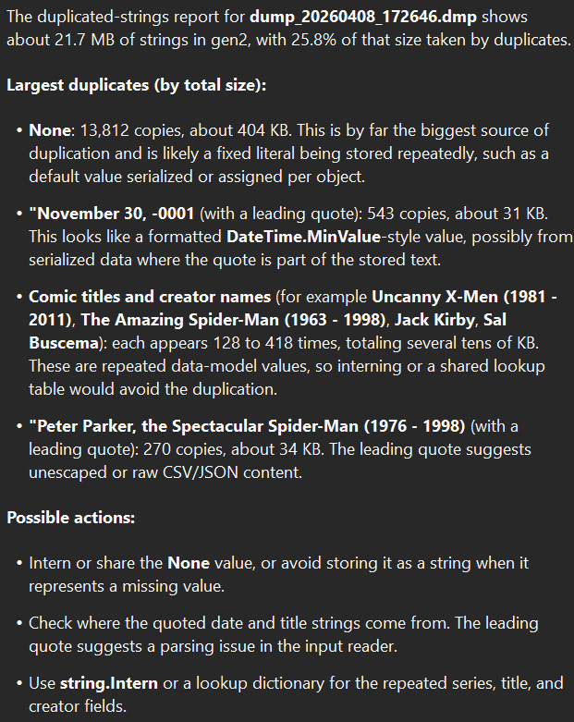
Use MCP Server in VS

Slide 32
Use MCP Server in VS Code
In Powershell
code --% --add-mcp "{\"name\":\"dstrings\",\"type\":\"stdio\",\"command\":\"dotnet-dstrings\",\"args\":[\"--mcp\"]}"

Slide 33
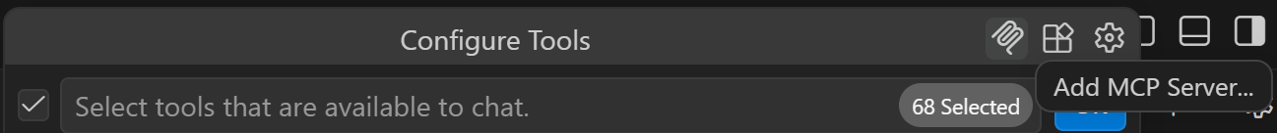
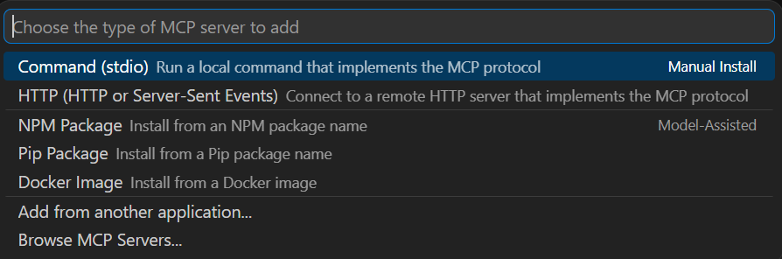
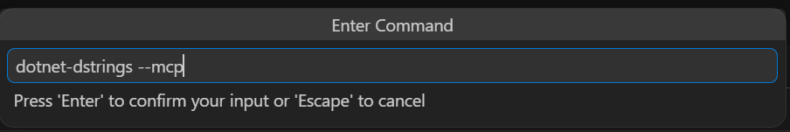
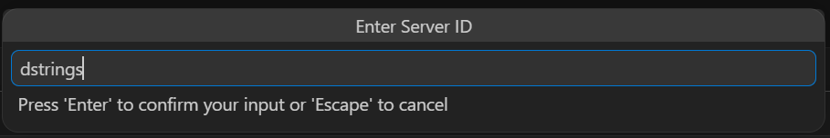
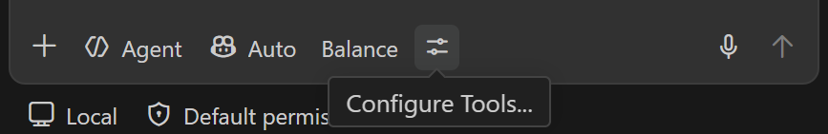
Use MCP Server in VS Code

Slide 34
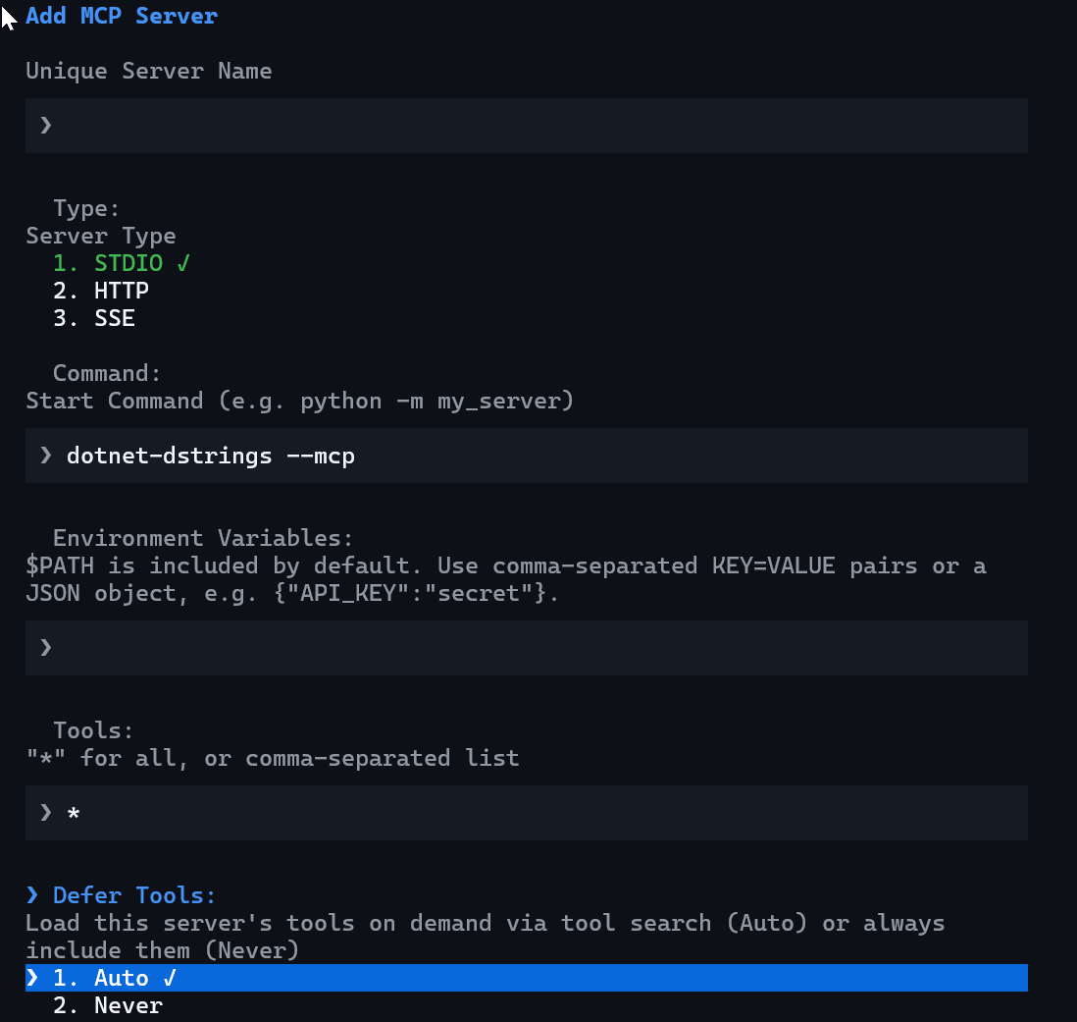
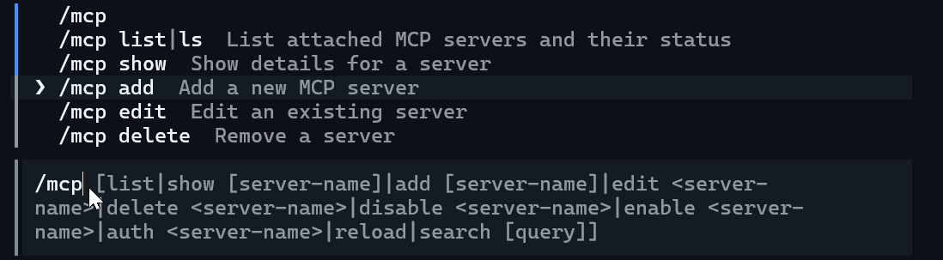
Use MCP Server in Copilot CLI
C:\Users\<user>\.copilot\mcp-config.json
/mcp add
Notes:
https://docs.github.com/en/copilot/how-tos/copilot-cli/use-copilot-cli-agents/overview#add-an-mcp-server

Slide 35
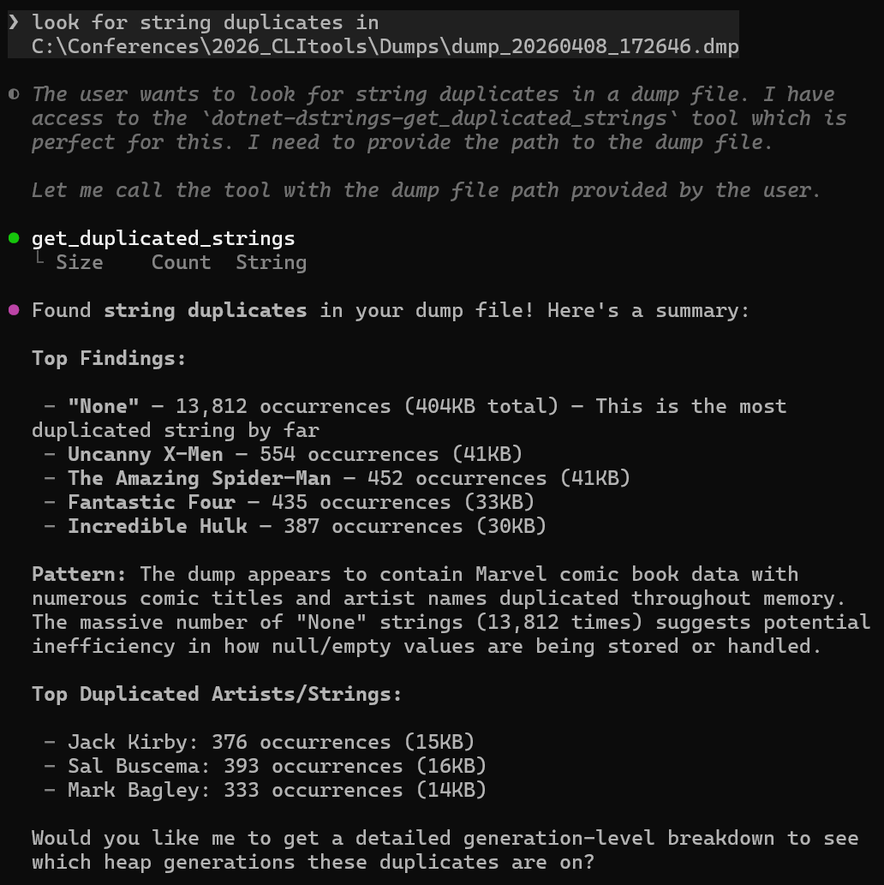
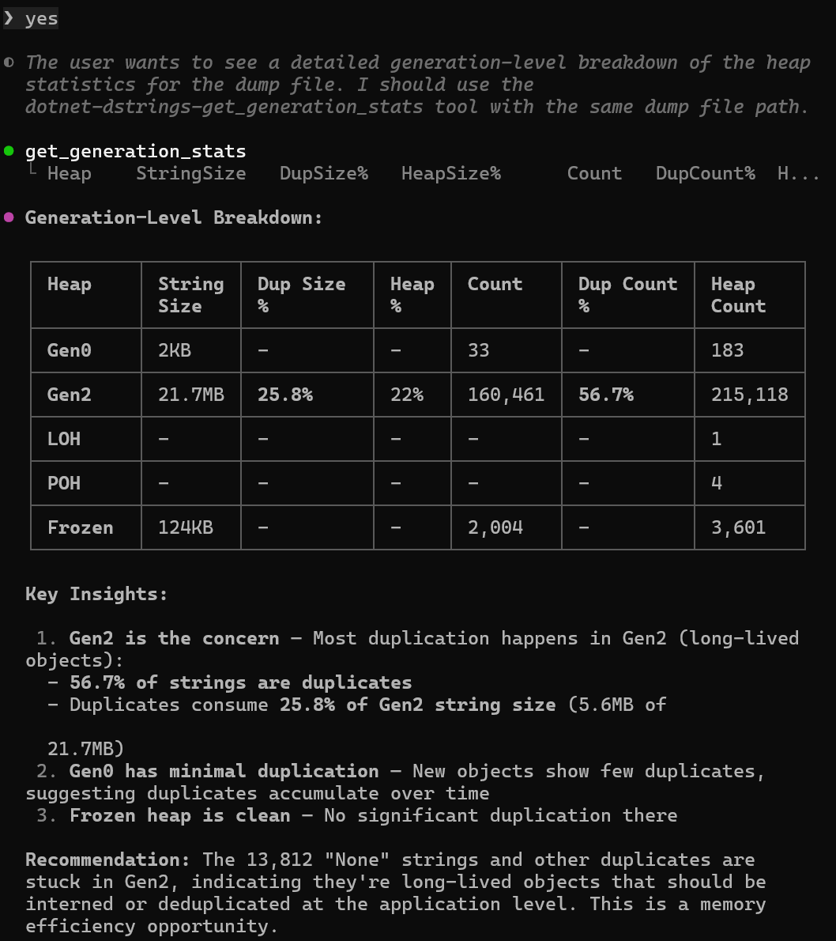
Use MCP Server in Copilot CLI
Notes:
https://docs.github.com/en/copilot/how-tos/copilot-cli/use-copilot-cli-agents/overview#add-an-mcp-server

Slide 36
Use MCP Server in Cursor
C:\Users\<user>\.cursor\mcp.json
{
"mcpServers": {
"dstrings": {
"command": "dotnet-dstrings",
"args": ["--mcp"]
}
}
}
Notes:
Read C:\Users\Christophe Nasarre\.cursor\mcp.json
It's configured in your global Cursor MCP config at ~/.cursor/mcp.json.
C:\Users\Christophe Nasarre\.cursor\mcp.json lines 1-8
{
"mcpServers": {
"dstrings": {
"command": “dotnet-dstrings",
"args": ["--mcp"]
}
}
}

Slide 37
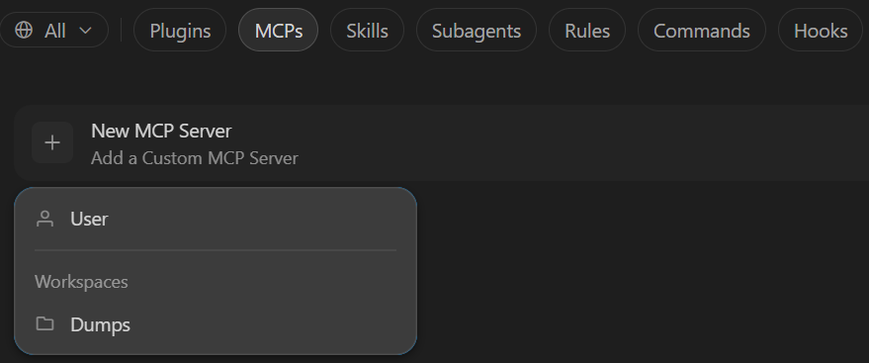
Use MCP Server in Cursor
In Cursor Settings / Customize…
Notes:
Read C:\Users\Christophe Nasarre\.cursor\mcp.json
It's configured in your global Cursor MCP config at ~/.cursor/mcp.json. It points to a local executable you built:
C:\Users\Christophe Nasarre\.cursor\mcp.json lines 1-8
{
"mcpServers": {
"dstrings": {
"command": “dotnet-dstrings",
"args": ["--mcp"]
}
}
}
So dstrings is an MCP server you registered yourself — it runs dstringsMCP.exe (a .NET 10 tool located under your
2026_CLItools\Research folder) and exposes the get_duplicated_strings tool. Cursor loads it automatically because
it's in the global ~/.cursor/mcp.json.

Slide 38
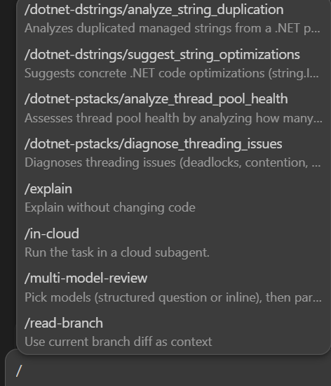
Use MCP Server in Cursor
Hint: find the prompts with /

Slide 39
Use MCP Server in Claude
claude mcp add -s user dstrings -- dotnet-dstrings --mcp
C:\Users\<user>\.claude.json
"mcpServers": {
"dstrings": {
"type": "stdio",
"command": "dotnet-dstrings",
"args": ["--mcp"],
"env": {}
}
}

Slide 40
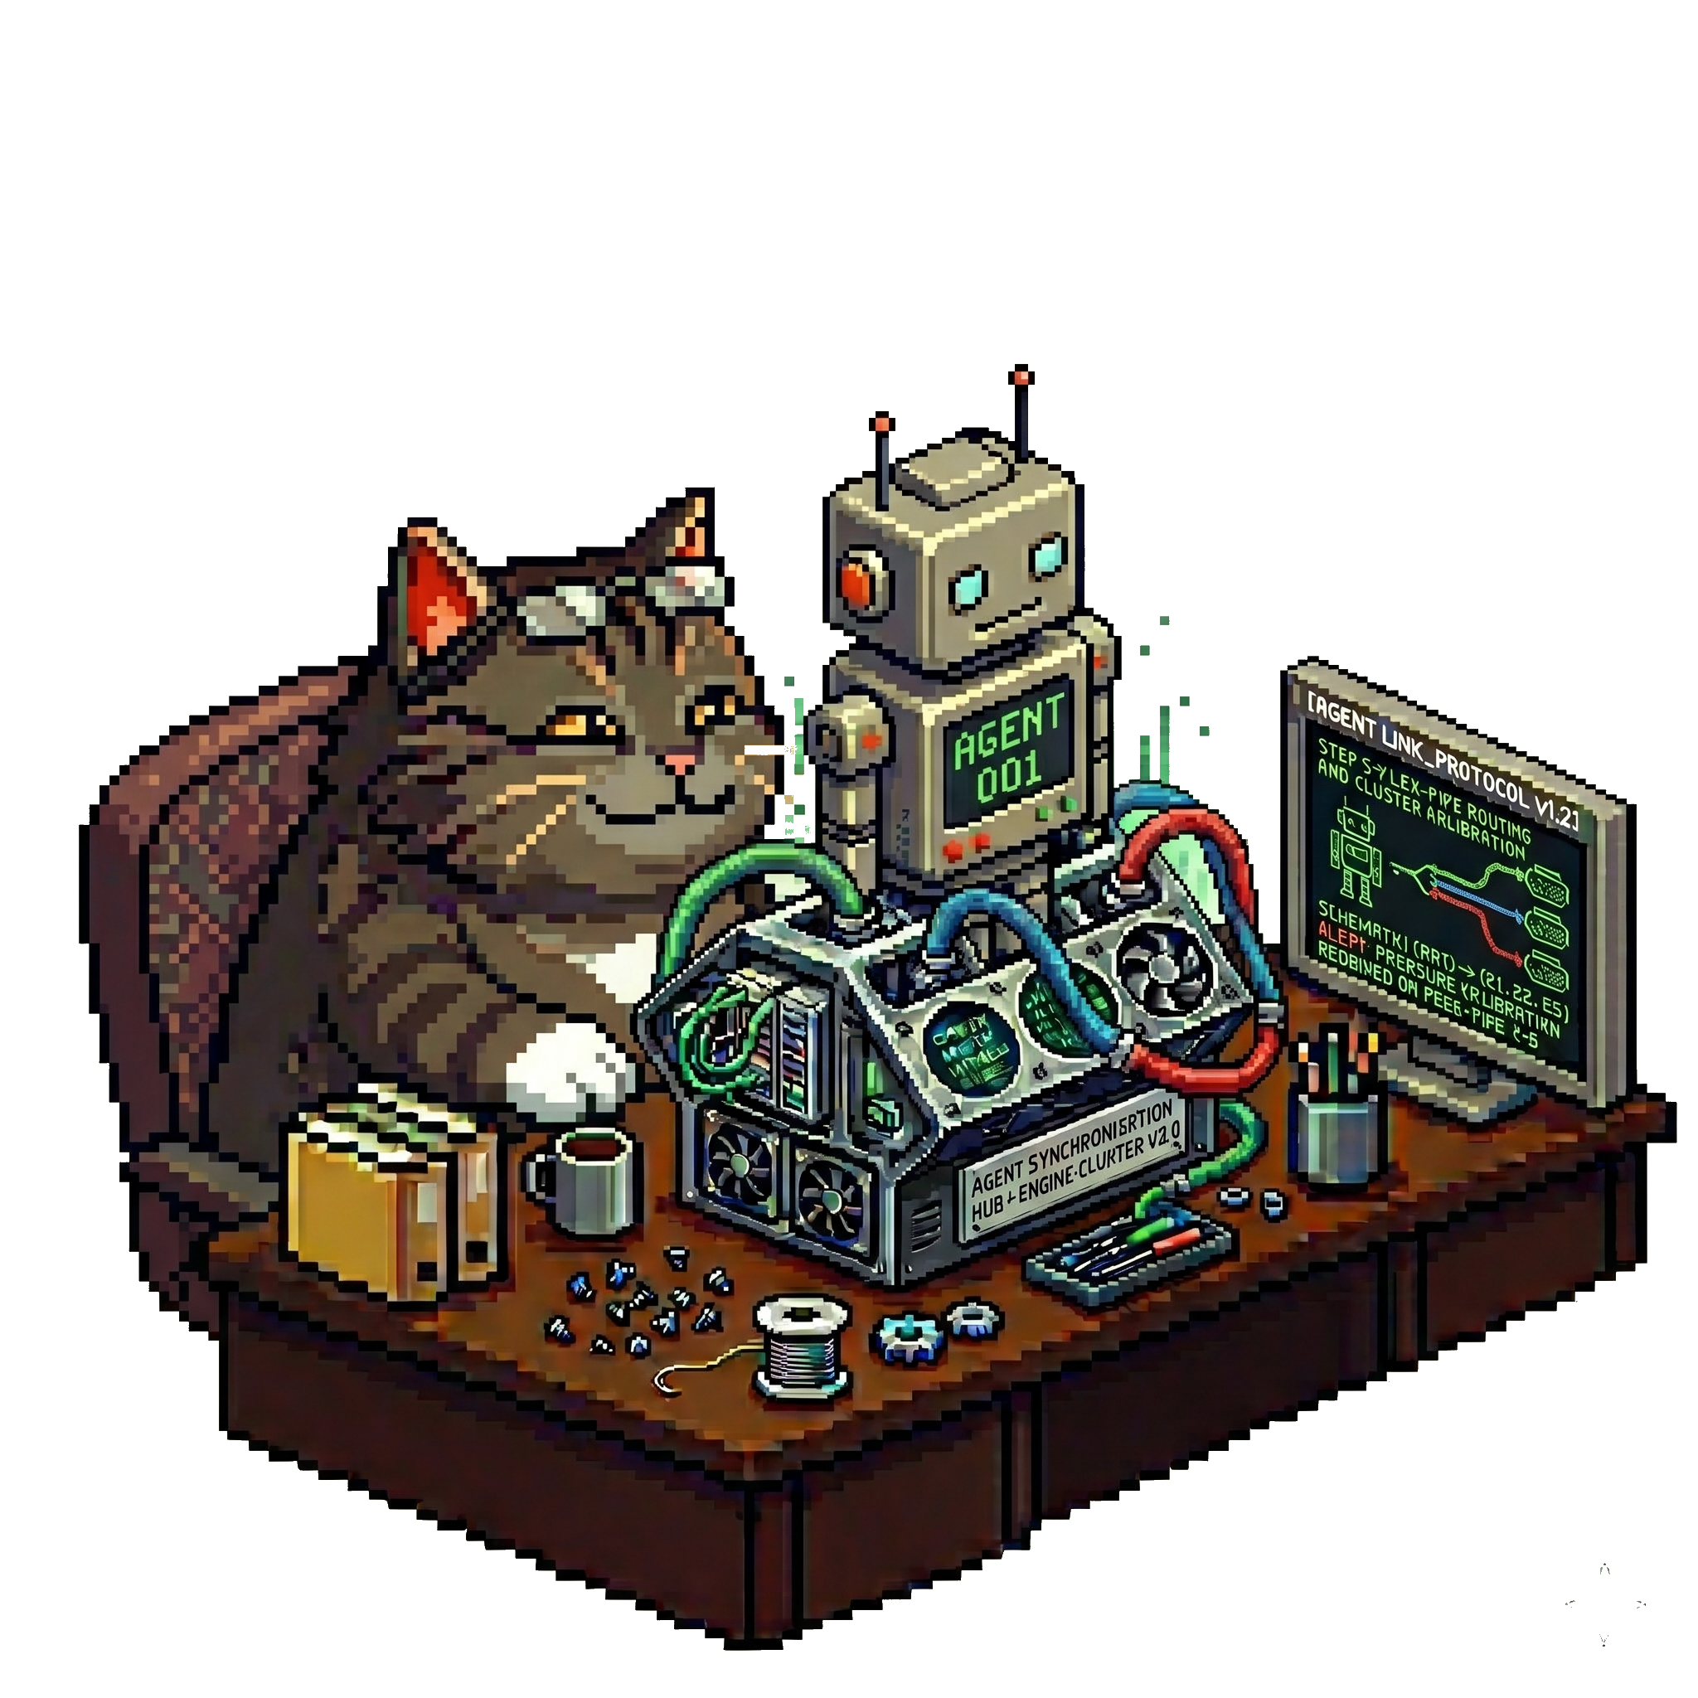
Use your skills Luke!
What if you can’t change the .NET CLI tool?
  Microsoft ones
  Third-party ones
  Keep your own as CLI tool: <PackageType>McpServer issue
Create a skill to orchestrate tools usage DEMO
---
name: dotnet-memory-analysis
description: >-
Analyze .NET application memory issues using CLI diagnostic tools…
---
Notes:
DEMO:
- Show the impact of having MCP tools with Process Explorer: they are always started even if not needed!!!
DEMO:
Show the content of C:\Users\Christophe Nasarre\.cursor\skills\dotnet-memory-analysis\SKILL.md (prerequisite, tools, walkthrough)
NOTE:
Impossible to analyze Windows dumps on Mac
TODO: try on WSL

Slide 41
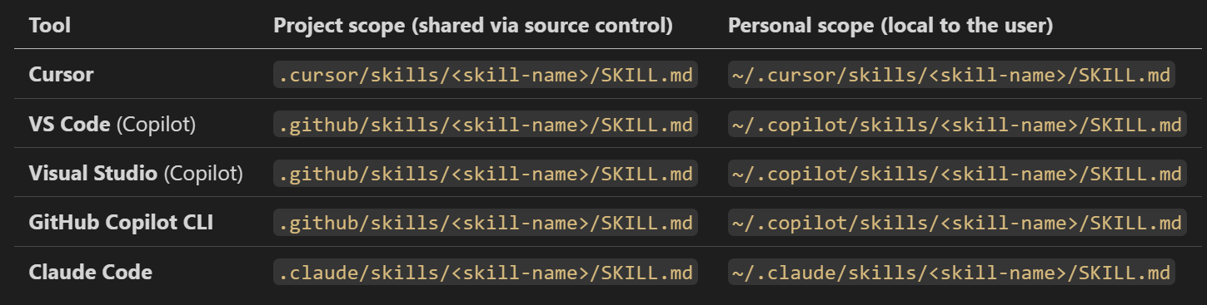
Install your skill
SKILL.md location

Slide 42
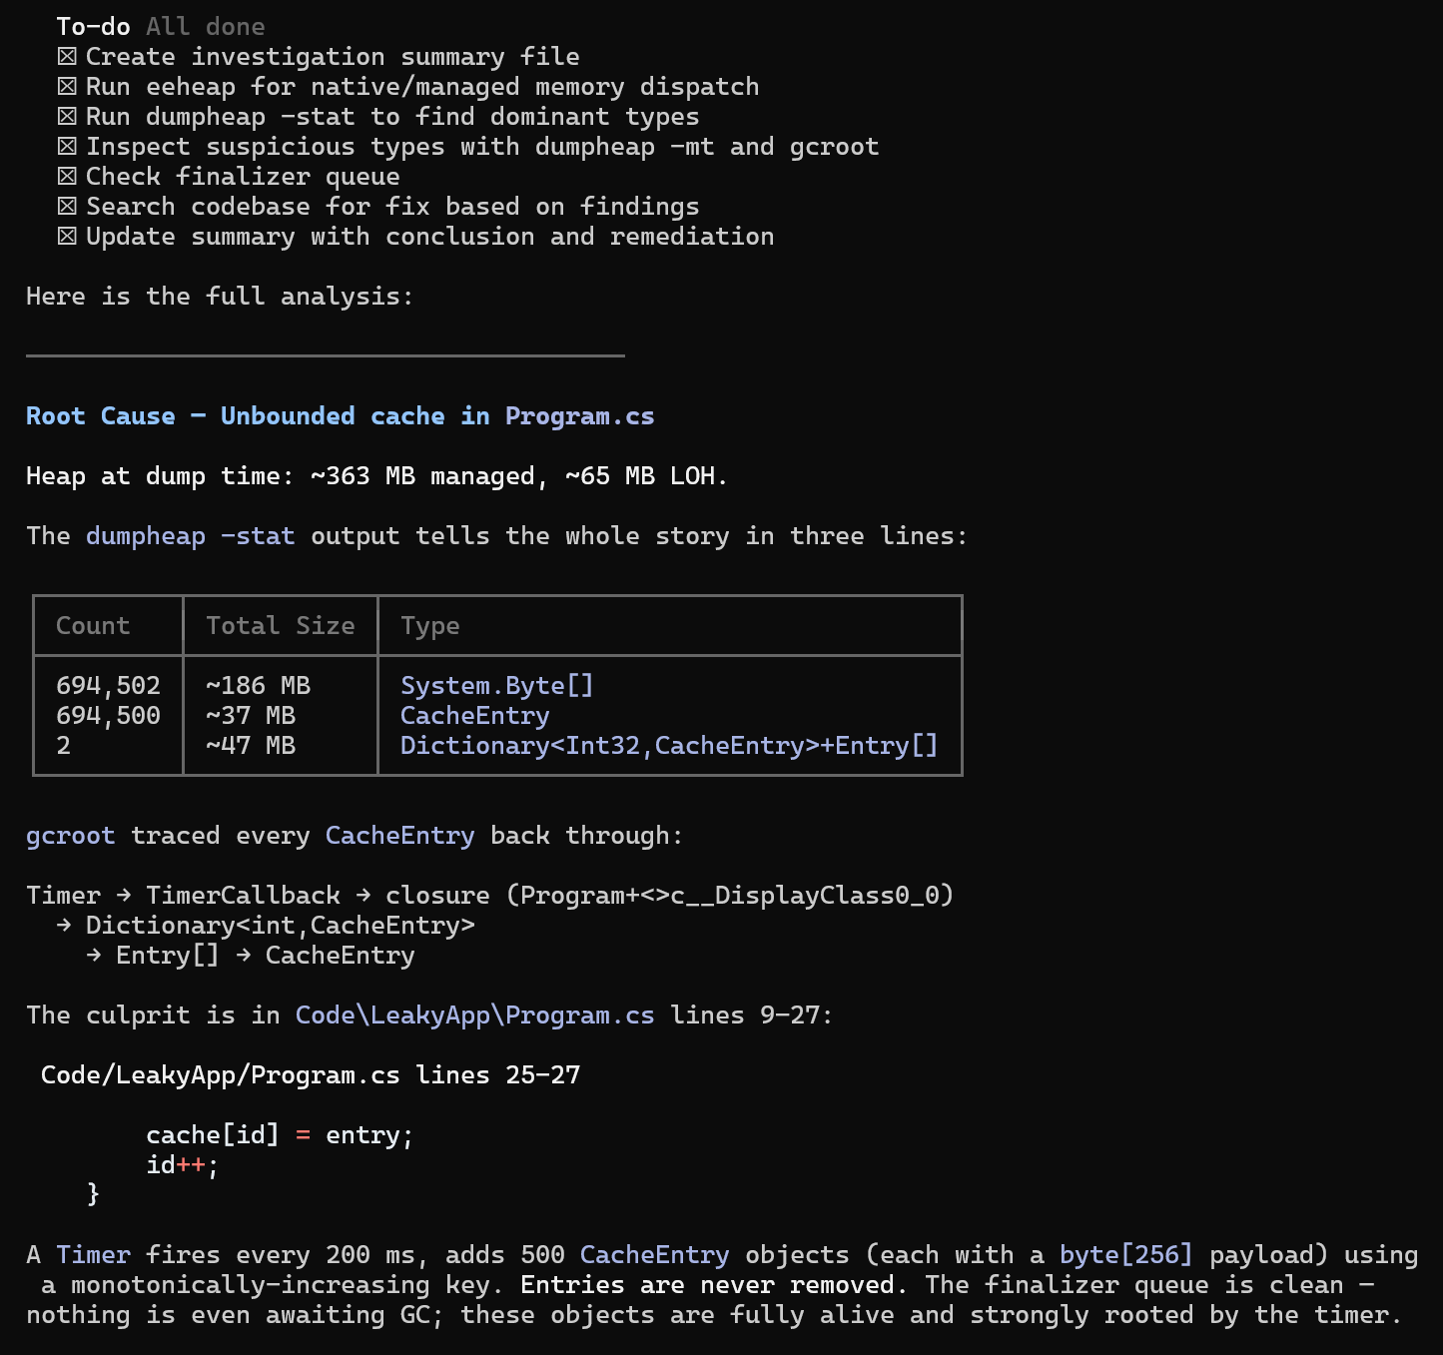
It is working :^)
The leakyApp seems to consume too much memory.
Analyze the problem and provide guidance to fix it.

Slide 43
It is working :^)
The leakyApp seems to consume too much memory.
Analyze the problem and provide guidance to fix it.

Slide 44
It is working :^)
The leakyApp seems to consume too much memory.
Analyze the problem and provide guidance to fix it.

Slide 45
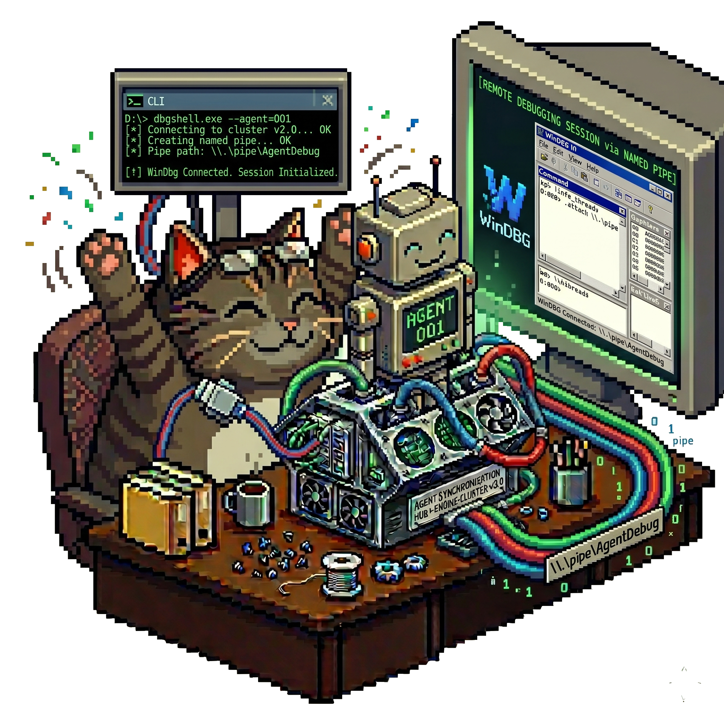
How to interact with GUI?
Windbg-bridge
  Provide a SKILL.md to “drive” the agent
  WinDBG extension to create a named pipe
  CLI tool to connect the named pipe

Slide 46
Resources
  Microsoft documentation
  https://learn.microsoft.com/en-us/dotnet/core/tools/global-tools
  https://learn.microsoft.com/en-us/dotnet/core/tools/global-tools-how-to-create
  Andrew Lock blog series (metrics and CLI)
  My Blog
  https://chrisnas.github.io
  This content (code + slides)
  https://github.com/chrisnas/UpdateConferencePrague2026

